Slide 1

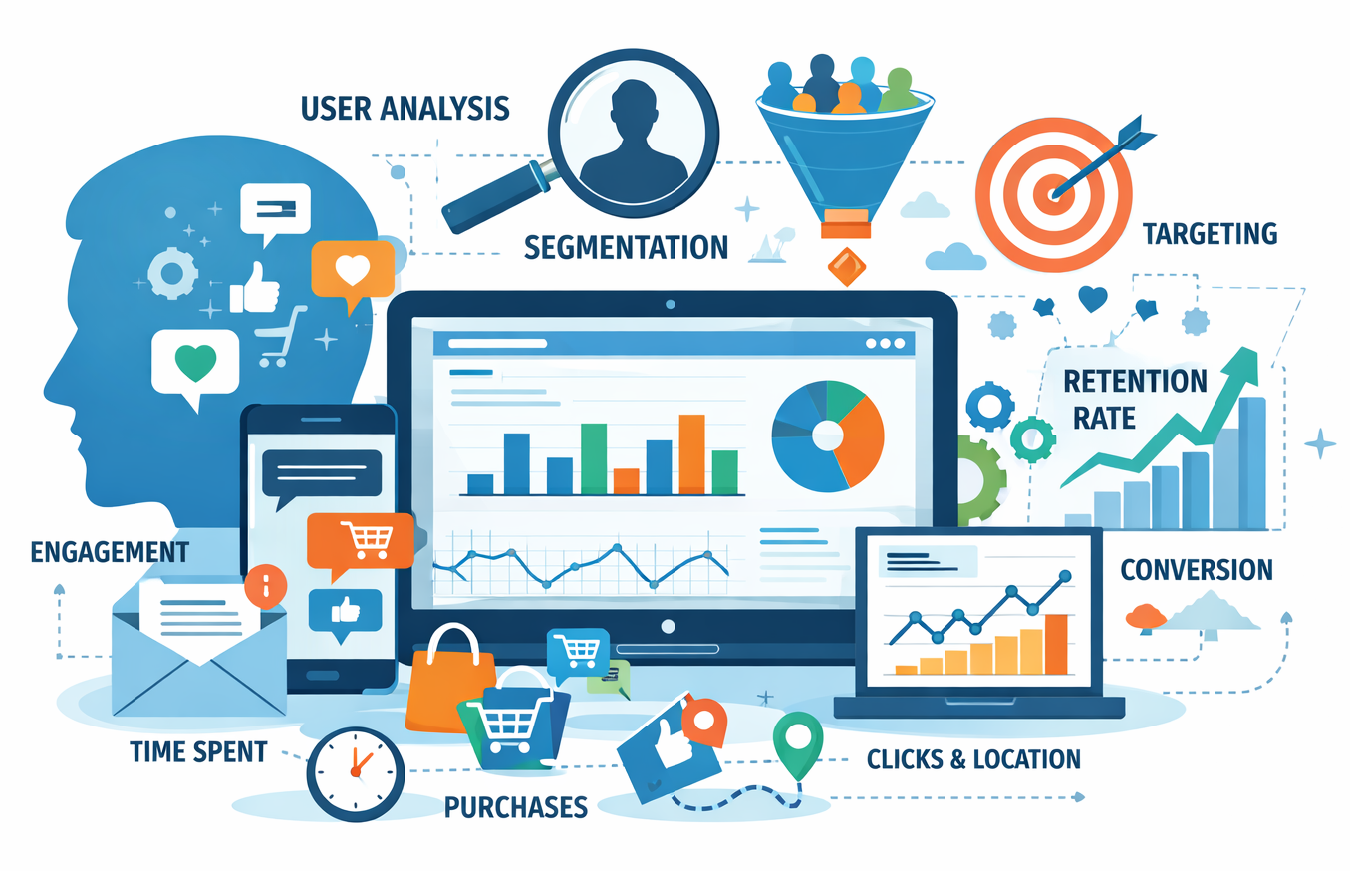

Active User Behavior & Segmentation Analyst Insight – OCA Indonesia
Virtual Internship Program RevoU & Telkom Indonesia
MikhaelPutraIswanto
Tuesday, 27 Januari 2026

Slide 2

Background & Business Problem
Business Background
OCA Indonesia, a Communications Platform as a Service solution solution by Telkom Indonesia, supports large-scale omnichannel messaging across multiple channels and clients. enables customer engagement through WhatsApp, SMS, Email, and Voice Call. However, growing usage complexity makes it challenging to identify user behavior differences and channel effectiveness. Clustering-based segmentation enables clearer insights into behavioral patterns, channel performance, and optimization opportunities.
DESCLAIMER
"The data provided is a representation of the original data which amount has been adjusted. The data used is NOT representation of original data, adjusted for educational purposes and does not reflect the actual business condition of the company."

Slide 3

Background & Business Problem
Business Problem
DARCI
How can OCA Indonesia leverage user behavior clustering to identify distinct customer segments, enable more relevant and personalized messaging, detect early signals of potential churn, and uncover upsell opportunities to improve delivery success and engagement in the next quarter?
Decision : C-Level Executive
Approver : Head of Business
Responsible : Data Analyst
Consulted : Product Managers
Marketing & Campaign
Informed : Operational Teams &
Management
DESCLAIMER
"The data provided is a representation of the original data which amount has been adjusted. The data used is NOT representation of original data, adjusted for educational purposes and does not reflect the actual business condition of the company."

Slide 4
EXECUTIVE SUMMARY
Problem
Objective
How can OCA Indonesia leverage user behavior clustering to identify distinct customer segments, enable more relevant and personalized messaging, detect early signals of potential churn, and uncover upsell opportunities to improve delivery success and engagement in the next quarter?
To understand and segment OCA Indonesia users based on behavioral patterns in order to enable personalization, early churn detection, and targeted upsell strategies that improve delivery success and customer engagement.
Findings
Recommendations
Growth depends on WhatsApp and Email, revenue concentrated in few Power Users, while quality-driven silent churn and missing mid-tier threaten scalability despite uniform engagement patterns.
Prioritize quality fixes for Power Users, focus on WhatsApp and Email, activate mid-tier via value-based upsell, and embed behavior-driven lifecycle management to reduce churn and revenue concentration.
DESCLAIMER
"The data provided is a representation of the original data which amount has been adjusted. The data used is NOT representation of original data, adjusted for educational purposes and does not reflect the actual business condition of the company."

Slide 5
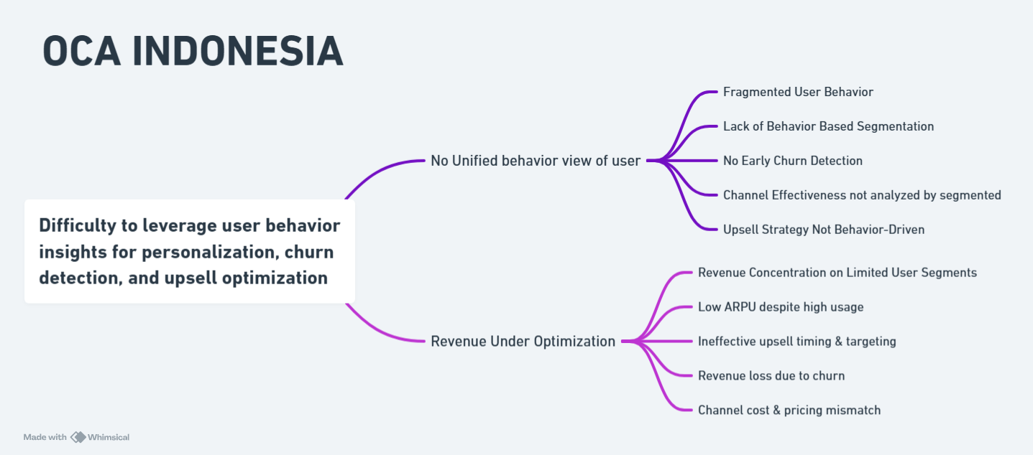
Root Cause Analyze

Slide 6
Project Objective
Behavioral Understanding Objective
Segmentation Objective (RFM & Clustering)
Revenue & Value Identification Objective
Analyze user behavior across channels and time to identify distinct usage patterns.
Create meaningful user segments using RFM and clustering techniques based on behavioral and transactional metrics.
Identify high-value and high-potential user segments to optimize revenue contribution.
Churn Risk Detection Objective
Channel & Engagement Optimization Objective
Detect early behavioral signals of potential churn across user segments.
Evaluate channel effectiveness and engagement patterns across segments to improve delivery success.
DESCLAIMER
"The data provided is a representation of the original data which amount has been adjusted. The data used is NOT representation of original data, adjusted for educational purposes and does not reflect the actual business condition of the company."

Slide 7


Project Scope & Dataset
X
Focus Area
Exclusion
Dataset
User 360 & Segmentation
Revenue & Profitability Mapping
Risk & Opportunity Detection
Net Profit , because we don’t have metric cost
Customer Sentiment, because we don’t have detail satisfied user
122.749 transactions
20 unique users
Main metric : user_id, channel_diversity, message_volume, active_days_df, tenure, success_rate, total_revenue, recency_days, is_dormant
DESCLAIMER
"The data provided is a representation of the original data which amount has been adjusted. The data used is NOT representation of original data, adjusted for educational purposes and does not reflect the actual business condition of the company."

Slide 8
Metriks Used
Nama | Detail
user_id | Key points.
channel_diversity | Number of unique channels (1 = Mono, >1 = Omni).
message_volume | Total transaction_id.
usage_frequency | daily engagement rate
active_days_df | Total unique transaction days (Consistency Indicator).
active_hours_df | Total unique transaction hours (Consistency Indicator).
transaction_id | count of transaction
total_price | how much user paid to ger monetary
created_at | date when user transaction
DESCLAIMER
"The data provided is a representation of the original data which amount has been adjusted. The data used is NOT representation of original data, adjusted for educational purposes and does not reflect the actual business condition of the company."

Slide 9
Metriks Used
Nama | Detail
avg_daily_volume | Average speed of messages sent by users per day
usage_trend | User performance indicators for the past week. Are they diligent (up) or lazy (down)
failure_rate | Percentage of messages that failed to send.
risk_category | User churn status
success_rate | Percentage of messages successfully delivered.
segment_name | User based on money and number of transactions.
hourly_data | Summary of transactions per hour
usage | Percentage of usage of a particular channel.
DESCLAIMER
"The data provided is a representation of the original data which amount has been adjusted. The data used is NOT representation of original data, adjusted for educational purposes and does not reflect the actual business condition of the company."

Slide 10
METHODOLOGY
Business Understanding
Data Collection
Data Cleaning
Measure channel effectiveness and segment user to gain strategies that improve delivery success and customer engagement.
Message transactions of OCA Indonesia (Whatsapp, Email, SMS, Call) from January - March 2025
Format datetime, remove duplicate, unified data, and calculated derived features (e.g., average transactions per day, tenure, ARPU)
Data Presentation
Data Visualization
Analyze
Cluster insight (high, medium, and low users) and cluster recommendation with high, medium
Use Histogram, Bar chart, Scatterplots, amd cluster summaries
Exploratory data analysis (distribution by channel, time, status) and Clustering by K=3 combined score
DESCLAIMER
"The data provided is a representation of the original data which amount has been adjusted. The data used is NOT representation of original data, adjusted for educational purposes and does not reflect the actual business condition of the company."

Slide 11

Exploratory Data Analysis
Total Transaction
122.748
Total Revenue
Rp. 25.946.370
Success Rate
79.54%
20 Users
ARPU
Rp. 1.297.321
DESCLAIMER
"The data provided is a representation of the original data which amount has been adjusted. The data used is NOT representation of original data, adjusted for educational purposes and does not reflect the actual business condition of the company."

Slide 12
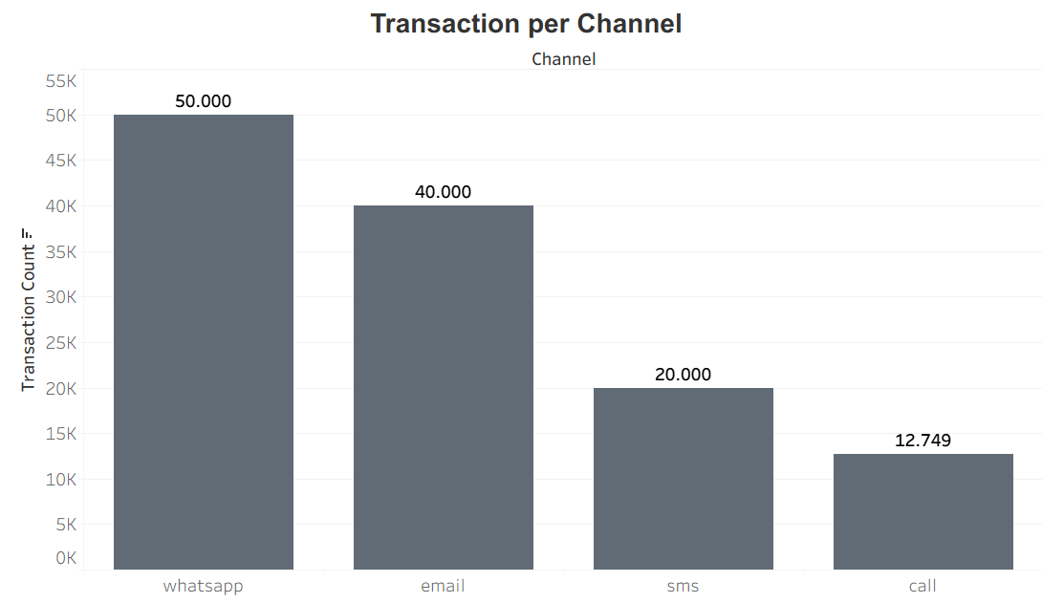
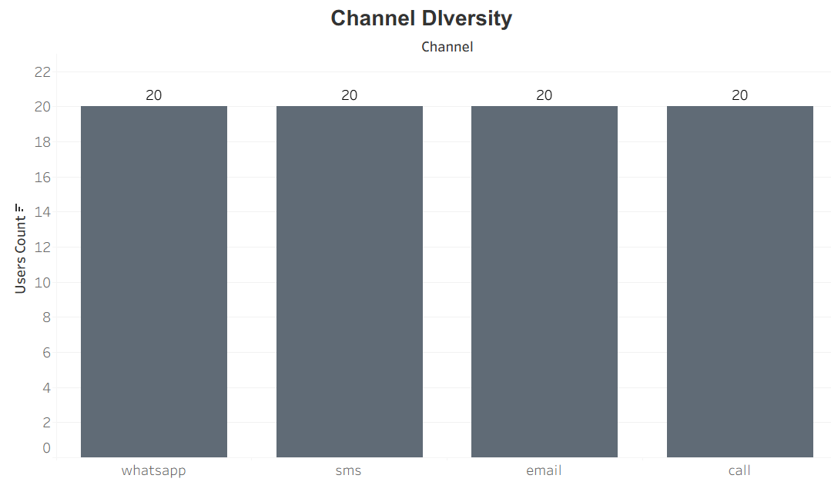
Behavioral Understanding
WhatsApp and Email dominate overall transaction, while SMS and Call remain marginal channels, suggesting that optimization efforts should prioritize WA and Email as the main drives of user communication
Users are evenly distributed across all channels, indicating strong omnichannel adoption.
DESCLAIMER
"The data provided is a representation of the original data which amount has been adjusted. The data used is NOT representation of original data, adjusted for educational purposes and does not reflect the actual business condition of the company."

Slide 13
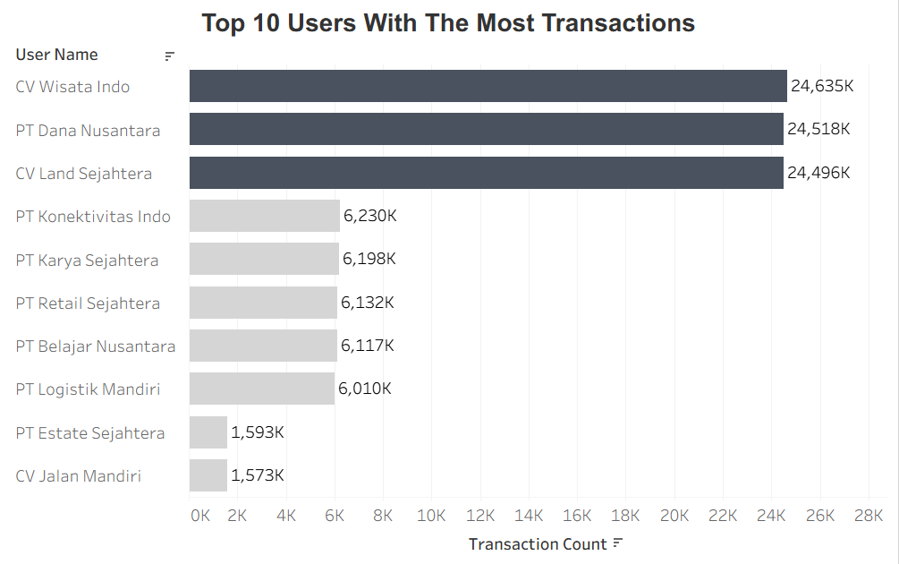
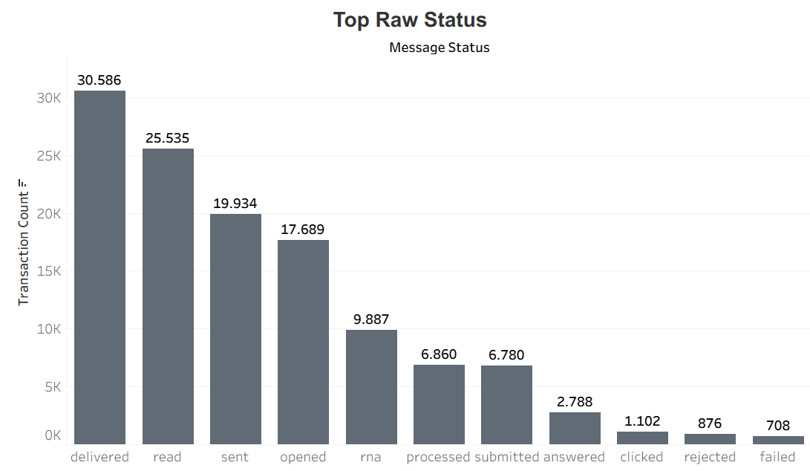
Most transactions reach the delivered and read stages, showing that the majority of messages are successfully transmitted and consumed, but the relatively high numbers in sent, opened, and RNA (Ring No Answer) highlight delivery bottlenecks, while the very low clicked rate indicates weak engagement
OCA’s usage is highly concentrated in the top three users generating over 24M transactions, creating high dependency risk. while mid-tier clients show growth constraints highlighting urgent retention needs and clear upsell opportunities.
DESCLAIMER
"The data provided is a representation of the original data which amount has been adjusted. The data used is NOT representation of original data, adjusted for educational purposes and does not reflect the actual business condition of the company."

Slide 14
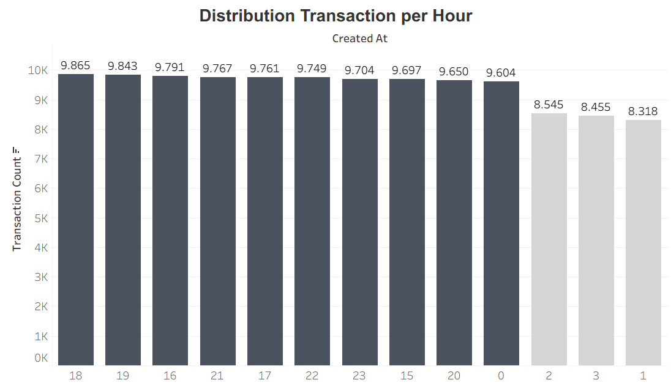
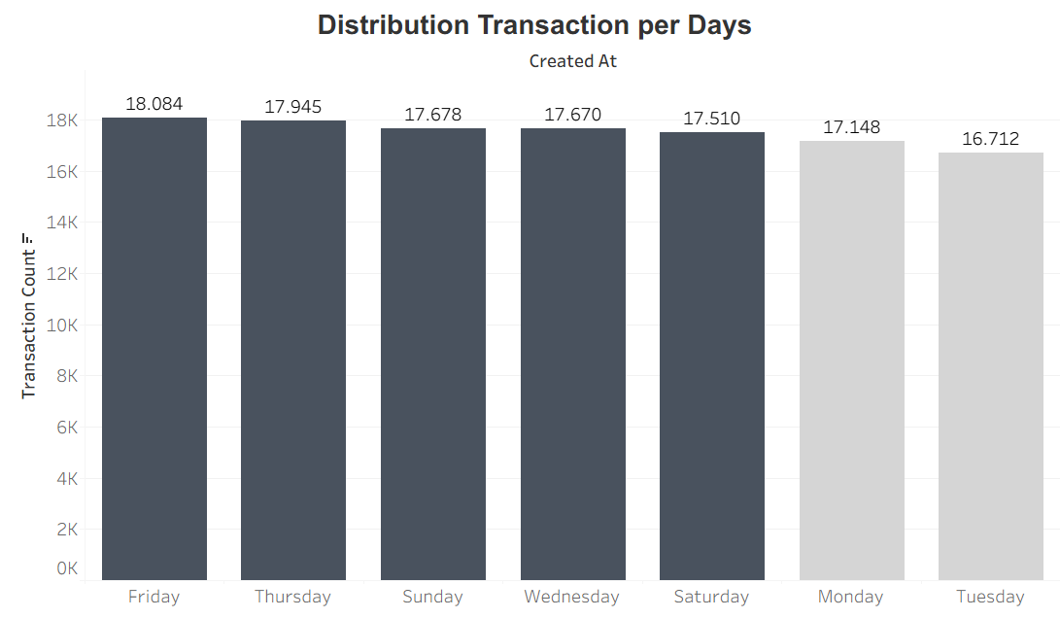
Message traffic peaks from 17:00 to 00:00 and remains active overnight, creating prolonged server load. This opens opportunities for premium priority routing and off-peak traffic optimization.
While Friday shows the highest transaction volume, weekday to weekend variation remains moderate 1.372 transactions (~7%), requiring full infrastructure readiness daily. Maintenance is best scheduled during low-traffic early Tuesday hours.
DESCLAIMER
"The data provided is a representation of the original data which amount has been adjusted. The data used is NOT representation of original data, adjusted for educational purposes and does not reflect the actual business condition of the company."

Slide 15
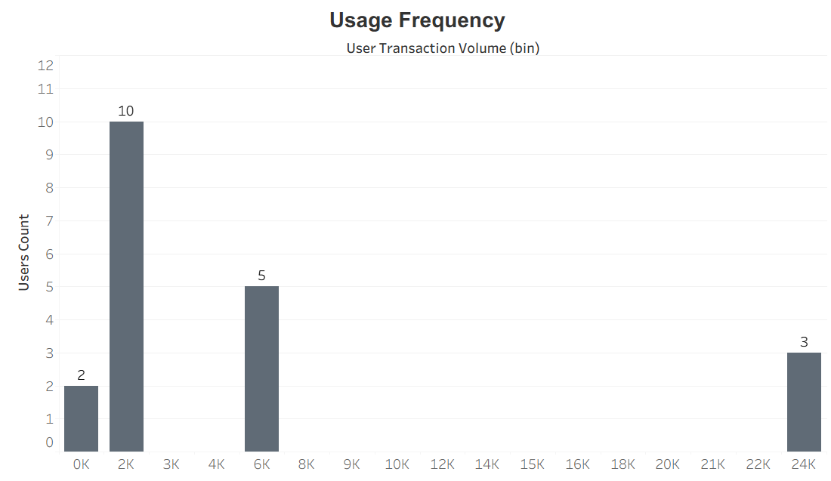
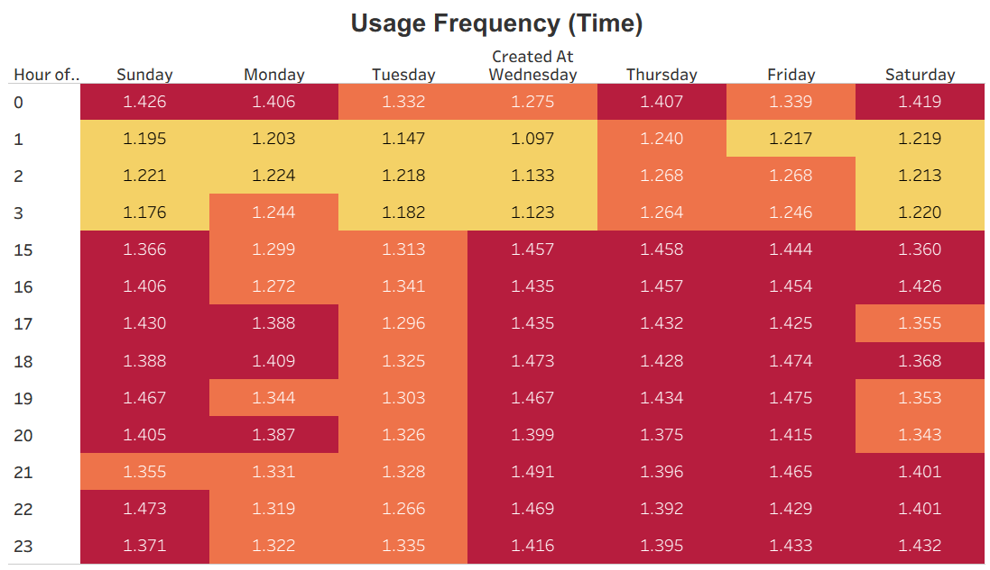
OCA’s user base is highly polarized, with a missing mid-tier that signals pricing gaps in user growth progression and highlights strong upsell potential from lower-volume users.
OCA Indonesia users are definitive 'Night Owls,' peaking between 7 PM and 11 PM, particularly on Wednesdays and Thursdays. To maximize impact, engagement strategies must shift from standard office hours to these evening slots, utilizing the 1 AM–3 AM lull strictly for maintenance.
DESCLAIMER
"The data provided is a representation of the original data which amount has been adjusted. The data used is NOT representation of original data, adjusted for educational purposes and does not reflect the actual business condition of the company."

Slide 16
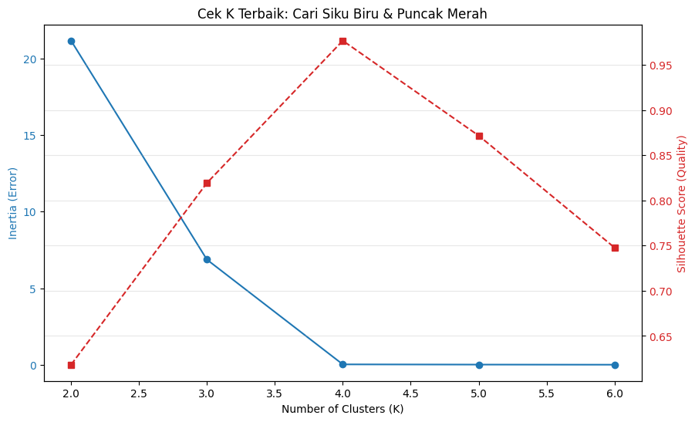
Segmentation
Based on the Elbow Method and silhouette analysis, user segmentation was performed using a combination of log-transformed frequency, log-transformed monetary value, and active days as a proxy for recency (due to uniform recency values). This analysis indicates that the optimal number of clusters is K = 3.
DESCLAIMER
"The data provided is a representation of the original data which amount has been adjusted. The data used is NOT representation of original data, adjusted for educational purposes and does not reflect the actual business condition of the company."

Slide 17
Segmentation
No | Segment | Characteristics | Suggest Actions
1 | POWER USER | Revenue Driver Declining Trend High Operational Consistency | Immediate Retention (Account-Based Marketing) Lock-in Mechanism with volume-based incentives or annual contract SLA Guarantee
2 | LOYAL USER | No Value Differentiation, identic with casual user High Volatility & Churn Unpredictable Pattern | Re-Segmentation Strategy Gamification & Upselling Churn Prevention Campaign with win back campaign via WhatsApp/Email with a user decline trend above 30%
3 | CASUAL USER | Omni-Channel Ready After-Hour Behavior Moderate Risk | Low-Touch Activation Time-Based Nudging before prime time Entry-Level Monetization
DESCLAIMER
"The data provided is a representation of the original data which amount has been adjusted. The data used is NOT representation of original data, adjusted for educational purposes and does not reflect the actual business condition of the company."

Slide 18
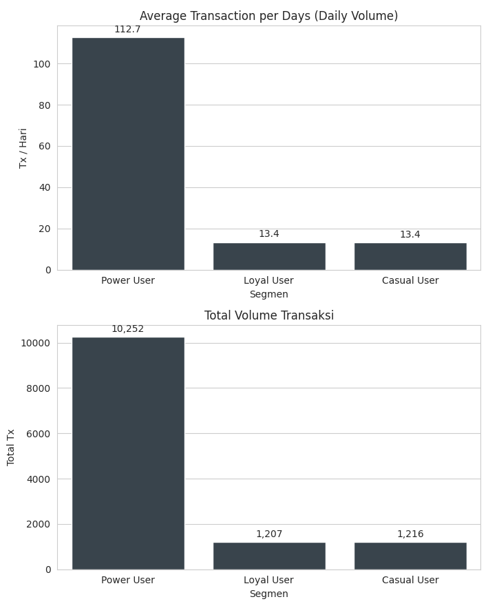

Revenue & Value Identification Objective
OCA's business is highly dependent on 8 Power Users who dominate transactions and revenue, while Loyal and Casual Users have nearly identical performance and lag far behind. Therefore, the strategy needs to prioritize Power User retention and redefine non-power segmentation.
DESCLAIMER
"The data provided is a representation of the original data which amount has been adjusted. The data used is NOT representation of original data, adjusted for educational purposes and does not reflect the actual business condition of the company."

Slide 19
Revenue & Value Identification Objective
user_name | user_id | monetary | frequency | active_days
CV Wisata Indo | user_3 | Rp 5,207,310 | 19,367 | 91
PT Dana Nusantara | user_2 | Rp 5,198,910 | 19,351 | 91
CV Land Sejahtera | user_1 | Rp 5,125,530 | 19,222 | 91
PT Retail Sejahtera | user_7 | Rp 1,327,690 | 4,853 | 91
PT Karya Sejahtera | user_5 | Rp 1,310,570 | 4,848 | 91
PT Logistik Mandiri | user_6 | Rp 1,294,970 | 4,725 | 91
PT Belajar Nusantara | user_8 | Rp 1,284,620 | 4,799 | 91
PT Konektivitas Indo | user_4 | Rp 1,276,070 | 4,854 | 91
There is extreme polarization among OCA users, with “The Big 3” (CV Wisata Indo, PT Dana Nusantara, CV Land Sejahtera) dominating revenue and traffic with a value almost 4 times that of other users. Uniquely, the retention rate is perfect because all users are fully active for 91 days, indicating that the OCA system has become a daily (operational) necessity. However, there is stagnation among mid-tier users whose transaction profiles are uniform, with no one standing out to grow into a new Power User.
DESCLAIMER
"The data provided is a representation of the original data which amount has been adjusted. The data used is NOT representation of original data, adjusted for educational purposes and does not reflect the actual business condition of the company."

Slide 20
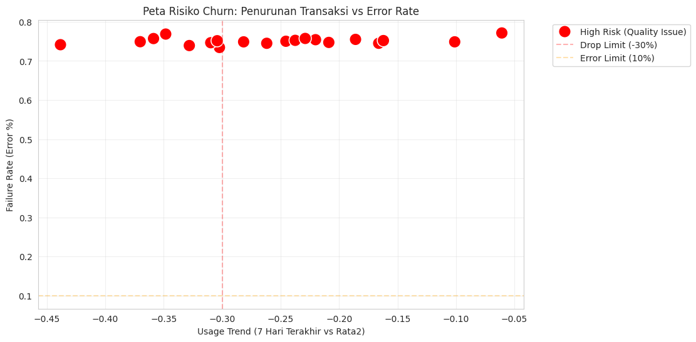
Churn Risk Detection
With zero recency, churn is detected via early warning signals, not inactivity.
user_id | segment_name | churn_probability | usage_trend | failure_rate | avg_daily_last_7d | avg_daily_prev
user_11 | Loyal User | High Risk (Quality Issue) | -43.8% | 74.2% | 7.9 | 14.0
user_9 | Casual User | High Risk (Quality Issue) | -37.0% | 74.9% | 8.6 | 13.6
user_12 | Casual User | High Risk (Quality Issue) | -35.9% | 75.7% | 8.4 | 13.1
user_19 | Loyal User | High Risk (Quality Issue) | -34.8% | 76.9% | 9.0 | 13.8
user_14 | Loyal User | High Risk (Quality Issue) | -32.8% | 73.9% | 9.1 | 13.6
user_6 | Power User | High Risk (Quality Issue) | -31.0% | 74.7% | 36.7 | 53.2
user_8 | Power User | High Risk (Quality Issue) | -30.4% | 75.2% | 37.6 | 54.0
user_17 | Loyal User | High Risk (Quality Issue) | -30.2% | 73.4% | 9.3 | 13.3
user_2 | Power User | High Risk (Quality Issue) | -28.2% | 74.9% | 156.1 | 217.4
user_13 | Loyal User | High Risk (Quality Issue) | -26.2% | 74.5% | 10.0 | 13.5
Even though users are still active (recency = 0), a sharp decline in usage trend (≤ -30%) accompanied by a consistently high failure rate (~75%) indicates a risk of early churn triggered by service quality issues. High RNA encourages transaction failures and causes users to gradually reduce volume (“silent churn”), which has the potential to develop into actual churn if not addressed immediately.
DESCLAIMER
"The data provided is a representation of the original data which amount has been adjusted. The data used is NOT representation of original data, adjusted for educational purposes and does not reflect the actual business condition of the company."

Slide 21
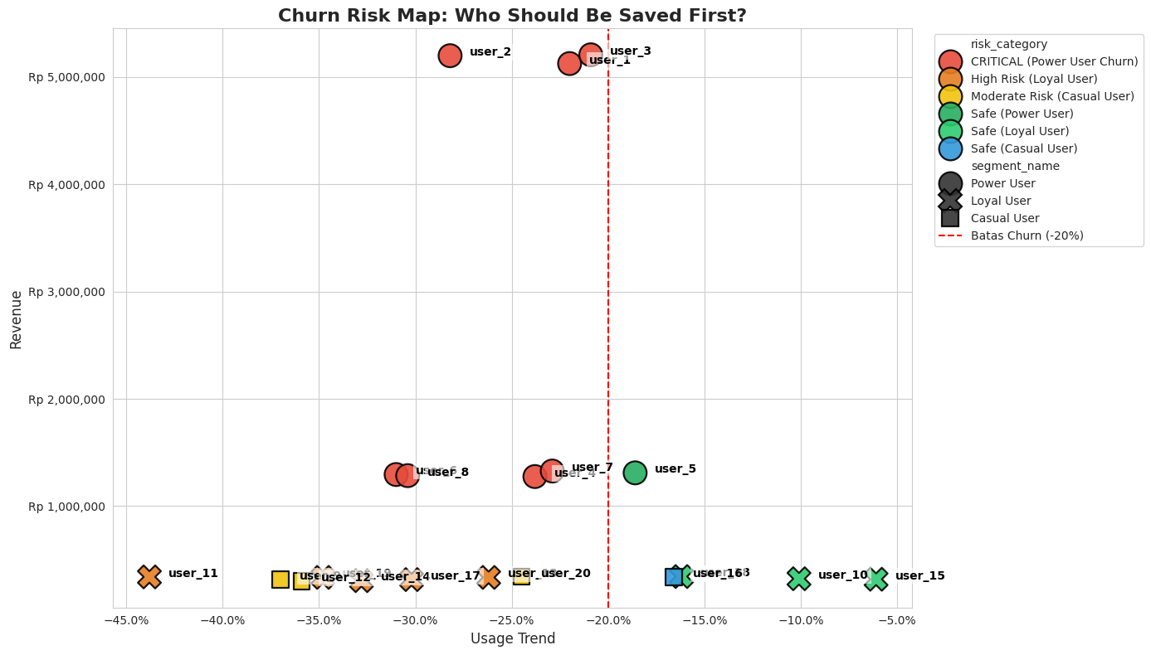
Churn Risk Detection
user_id | risk_category | usage_trend | revenue | success_rate
user_15 | Safe (Loyal User) | -6.1% | Rp 318,840 | 22.8%
user_19 | High Risk (Loyal User) | -34.8% | Rp 336,210 | 23.1%
user_7 | CRITICAL (Power User Churn) | -22.9% | Rp 1,327,690 | 24.2%
user_12 | Moderate Risk (Casual User) | -35.9% | Rp 300,770 | 24.3%
user_5 | Safe (Power User) | -18.6% | Rp 1,310,570 | 24.5%
user_1 | CRITICAL (Power User Churn) | -22.0% | Rp 5,125,530 | 24.6%
user_4 | CRITICAL (Power User Churn) | -23.8% | Rp 1,276,070 | 24.7%
user_8 | CRITICAL (Power User Churn) | -30.4% | Rp 1,284,620 | 24.8%
user_18 | Safe (Loyal User) | -16.2% | Rp 344,080 | 24.8%
user_20 | Moderate Risk (Casual User) | -24.5% | Rp 342,240 | 25.0%
Although all users appear to be actively logged in, data from the last 7 days shows a sharp decline in product usage. The highest churn risk comes from key Power Users (Users 1–3), with a usage decline of up to −28%, indicating silent churn. Saving “The Big 3” is a critical priority because their impact on cash flow is much greater than that of other users.
DESCLAIMER
"The data provided is a representation of the original data which amount has been adjusted. The data used is NOT representation of original data, adjusted for educational purposes and does not reflect the actual business condition of the company."

Slide 22
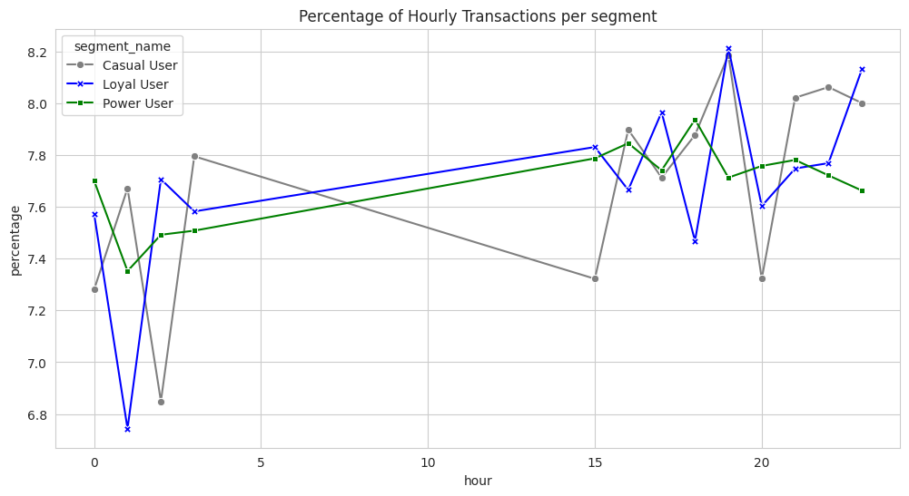
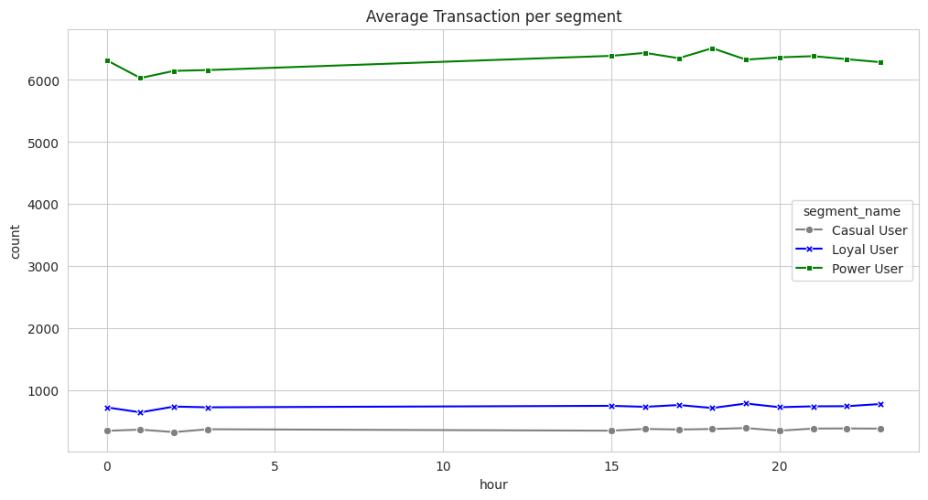
Channel & Engagement Optimization
No. High-volume users do not show unique hourly patterns. All user segments are active at the same time (starting at ±3:00 p.m., peaking at ±7:00 p.m.). The only difference is in consistency, Power Users are more stable and planned, while Casual Users are more volatile. No special timing strategy is needed for High-volume users.
Analysis of transaction patterns proves that Power Users do not have “special hours” or unique time patterns. They are active in the same time zone as other users, becoming busy in the afternoon and peaking at 7 p.m.
DESCLAIMER
"The data provided is a representation of the original data which amount has been adjusted. The data used is NOT representation of original data, adjusted for educational purposes and does not reflect the actual business condition of the company."

Slide 23
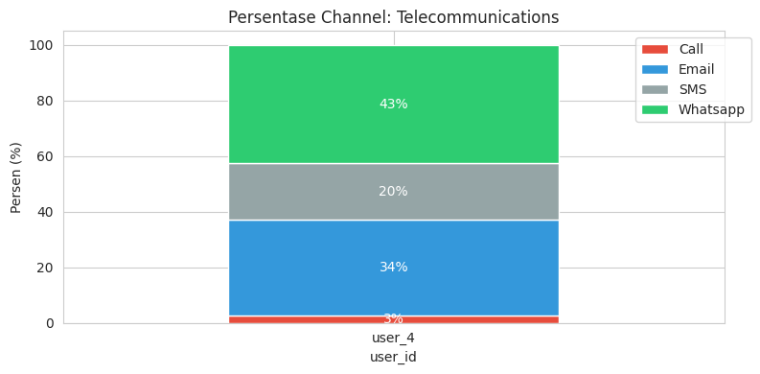
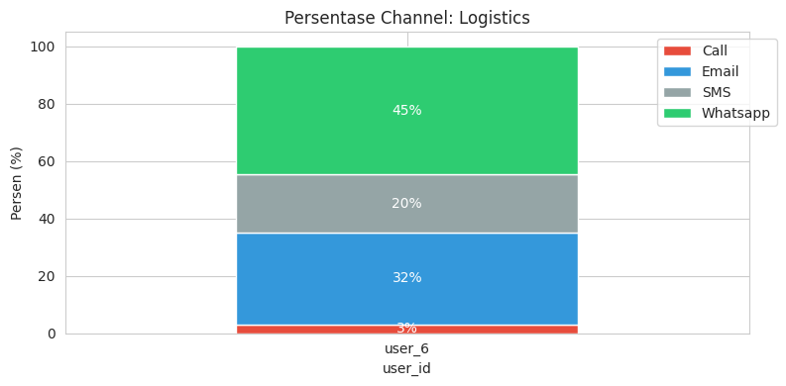
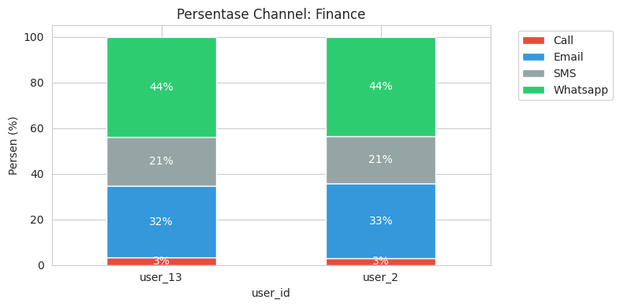
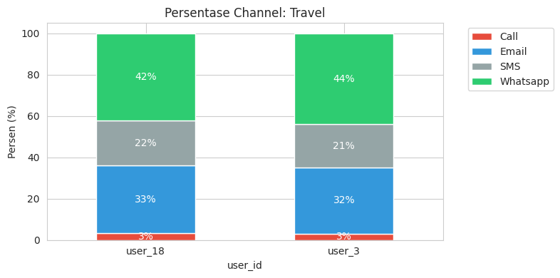

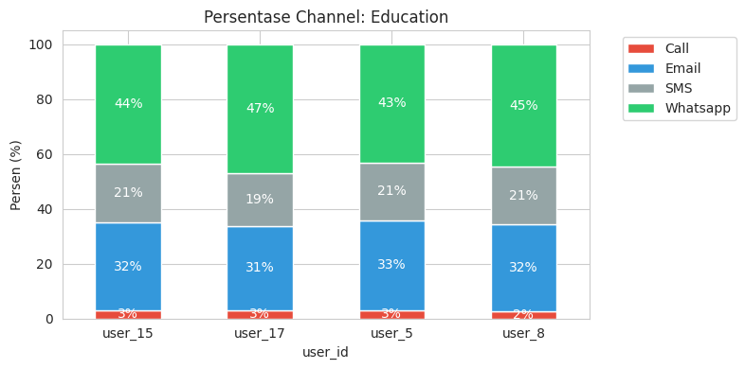
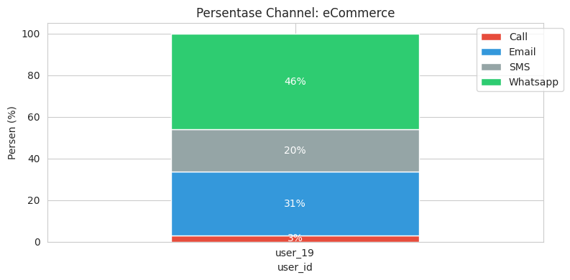
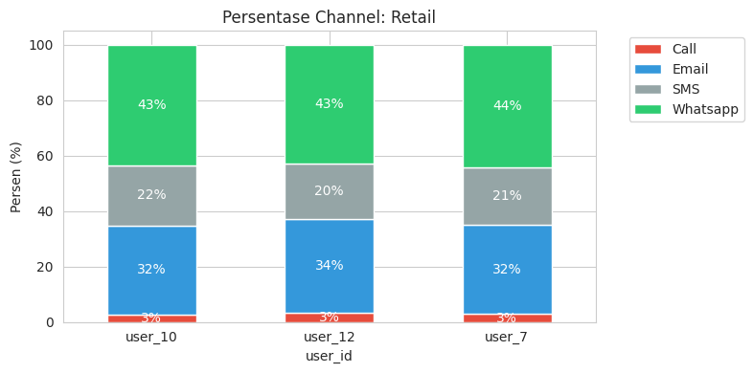
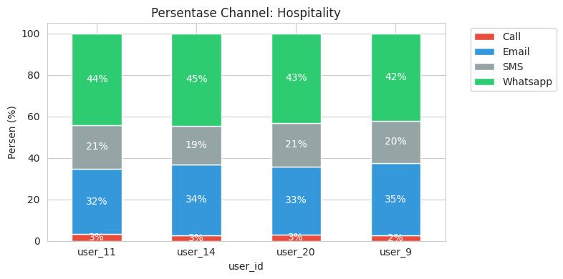
Channel & Engagement Optimization
Data shows that all users are omni-channel, with consistent usage patterns across industries WhatsApp dominates, followed by email, while SMS and calls play a minor role. Since there are no mono-channel users, upsell strategies involving the addition of channels are irrelevant. Revenue opportunities lie in cross-selling quotas and premium add-ons on the most frequently used main channels, especially WhatsApp and email.
DESCLAIMER
"The data provided is a representation of the original data which amount has been adjusted. The data used is NOT representation of original data, adjusted for educational purposes and does not reflect the actual business condition of the company."

Slide 24
Summary Insight
Behavioral | WA & Email are the core growth engines Usage is heavily concentrated in a few top clients High delivery success but elevated RNA and low engagement User activity peaks at night (7 - 11 PM) with sustained overnight load
Segmentation | User segmentation using log-transformed frequency, monetary value, and active days (as a recency proxy) indicates three optimal clusters (K = 3) based on Elbow and Silhouette analysis. (Power User, Loyal user, and Casual User)
Revenue | A small group of Power Users led by “The Big 3” dominates transactions and revenue Retention is artificially perfect Loyal and Casual users show stagnant and nearly identical performance There is no natural pipeline for new Power Users
DESCLAIMER
"The data provided is a representation of the original data which amount has been adjusted. The data used is NOT representation of original data, adjusted for educational purposes and does not reflect the actual business condition of the company."

Slide 25
Summary Insight
Churn Risk | Despite zero recency, usage has dropped sharply (≤ −30%) alongside a persistently high failure rate (~75%) High RNA is a key driver of transaction failures The highest churn risk sits with Power Users, especially “The Big 3 Retaining the top users is critical to cash flow stability
Engagement | High-volume (Power) users do not exhibit unique hourly behavior The key difference across segments is consistency, not timing All users are fully omnichannel Channel-based upsell is not relevant
DESCLAIMER
"The data provided is a representation of the original data which amount has been adjusted. The data used is NOT representation of original data, adjusted for educational purposes and does not reflect the actual business condition of the company."

Slide 26
Recommendation
Timing | Detail | Recommendation
Short Term fix quality and save Power Users | Protect revenue, reduce silent churn, improve delivery quality. | Prioritize quality fixes for Power Users (“The Big 3”) Implement a behavior-based Early Warning System Focus on optimizing WhatsApp and email only Adjust operations to night-peak usage (7–11 PM)
Mid Term activate the missing middle | Reduce dependence on top users and activate mid-tier users. | Redefine segmentation beyond volume Build a “Next Power Users” pipeline Shift upsell strategy from channel to value
Long Term build a scalable, quality-led growth engine | Scalable system, balanced revenue, controlled churn. | Institutionalize behavior-based lifecycle management Reduce revenue concentration risk Develop quality-led product differentiation Predictive churn & growth modeling
DESCLAIMER
"The data provided is a representation of the original data which amount has been adjusted. The data used is NOT representation of original data, adjusted for educational purposes and does not reflect the actual business condition of the company."

Slide 27

THANKS!
Do you have any questions?
mikhaelput@gmail.com
081932613746

Slide 28



Appendix

